Slide 1
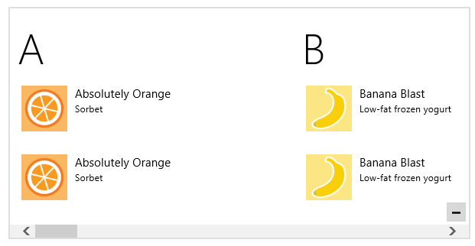
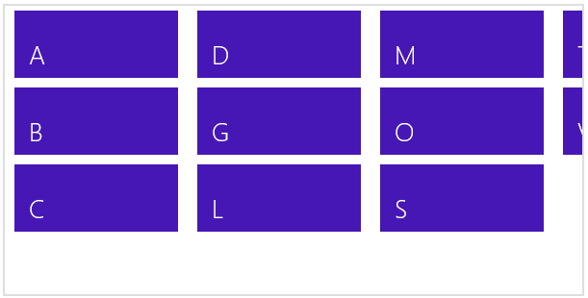
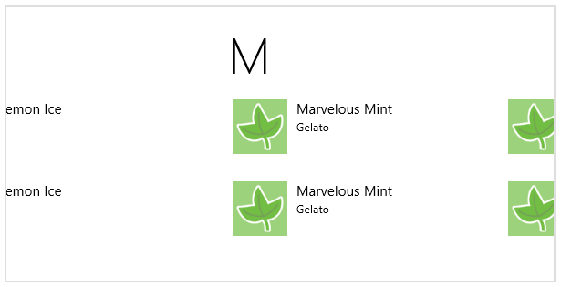
Zoomed-in view
Zoom control (overlay)
Zoomed-out view
Zoom out
Zoomed-in view
Tap an item or zoom in with focus on that item

Slide 2

<!-- Markup in your HTML file -->
<div data-win-control="WinJS.Binding.Template"> [your template content]
</div>
<div class="[your classes]" data-win-control="WinJS.UI.FlipView">
</div>
<!-- Results in the DOM -->
<div class="win-flipview [your classes]">
<div>
<div>
<div class="win-surface">
<div class="win-item">
[your template content]

Slide 3
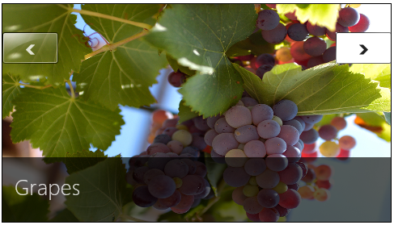
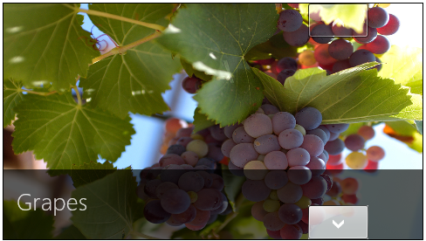
win-navleft
win-navright
win-navtop
shown with :active pseudo-class
win-navbutton
win-navbottom
shown with :hover pseudo-class

Slide 4
Object with IListDataSource
move*
insert*
Data Source
(items)
etc.
Collection Control
Private
channel
createListBindings
Object with IListBinding
first, last, current, etc.
Notification Handler IListNotificationHandler
from*
Call retain to get change notifications
ItemPromise (IItemPromise)
retain, etc.
Item (IItem)
(properties)

Slide 5
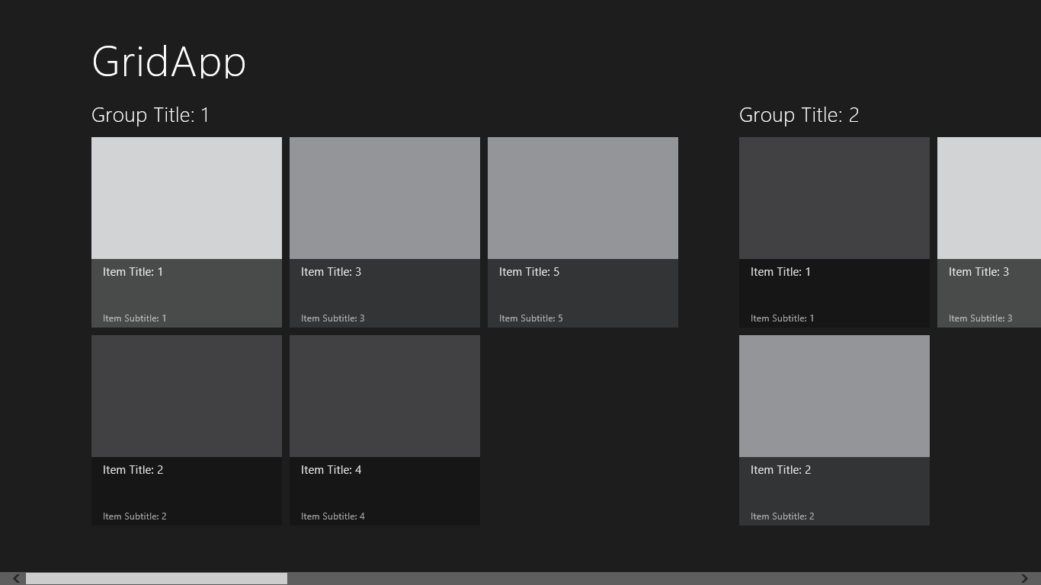
Page Header Area
Group headers
Items rendered from template
ListView Control (full bleed to sides)

Slide 6
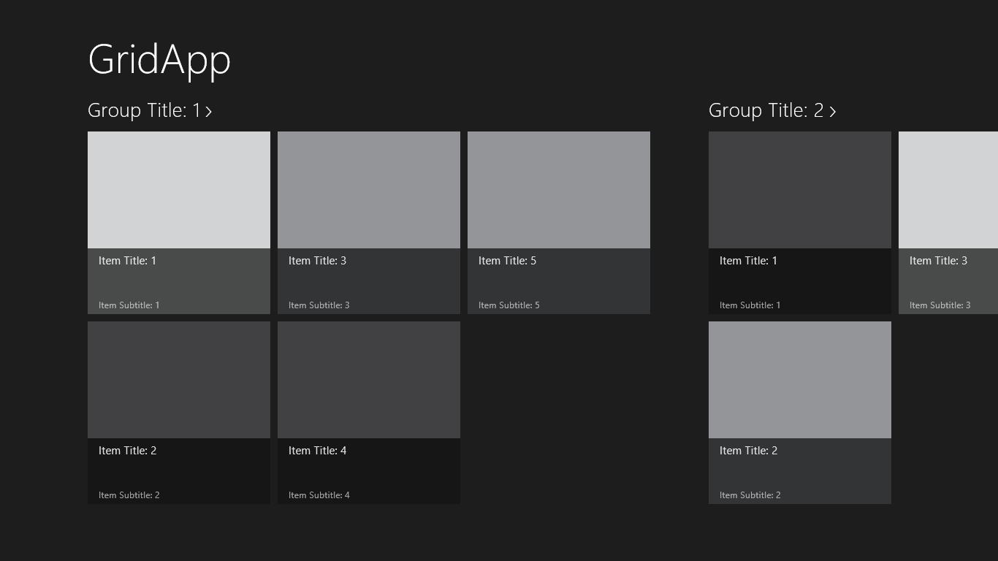
Page header area
Invocable group headers
Items rendered from template
ListView control (full bleed to sides)

Slide 7
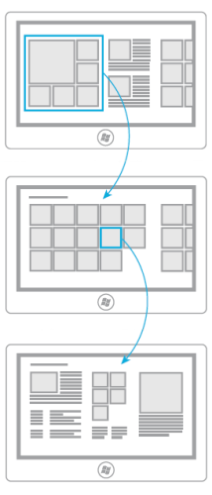
Hub page: page is a div; sections in a grid are either divs or ListViews; if the first section has variable items, it could be a ListView.
div with layout
Section page: the body of the page (excluding a page header) is a single ListView.
ListView
Detail page: page is a div; sections in a grid are either divs or ListViews.

Slide 8
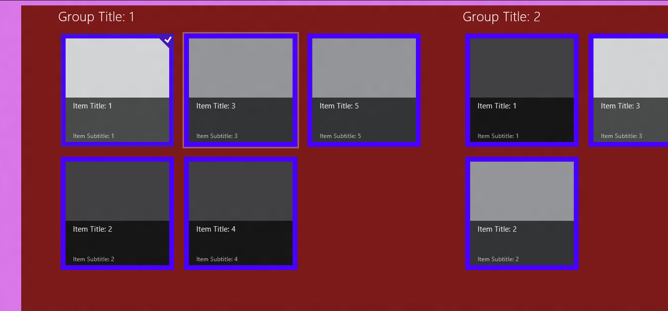
win-selectioncheckmark
win-selectioncheckmarkbackground (alt: win-selectionstylefilled)
win-groupheader
win-listview (entire control)
win-focusedoutline
win-viewport (non-scrolling area)
win-container (the area around an item really only to style margin and transparency)
item template styles (the area inside an item)
win-surface (the scrollable area)

